Slide 1
How influential are music critics?
Gradon Nicholls
Dec 6, 2021

Slide 2
Motivation
Economics: consumer demand
How does positive or negative reviews impact consumer demand for music?
Non-linearity? Both negative and positive reviews drive increased sales?
Does this differ for big name artists vs. smaller artists?
Does “new media” have more of an impact than “old media”
How correlated are customer reviews and critic reviews?
Idea: regress number of listens of an album on critic scores

Slide 3
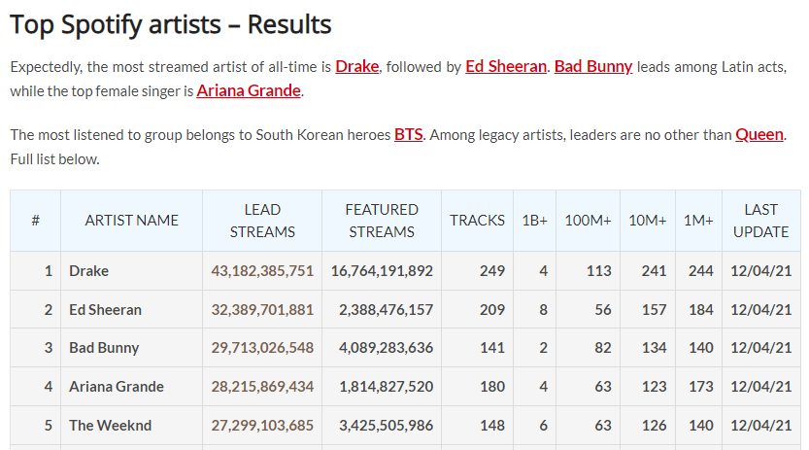
Data I – List of artist names
1,000 most-streamed artists on Spotify as of Nov 1, 2021
Source: https://chartmasters.org/most-streamed-artists-ever-on-spotify/

Slide 4
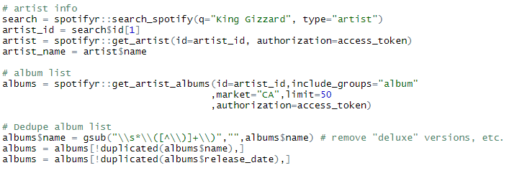
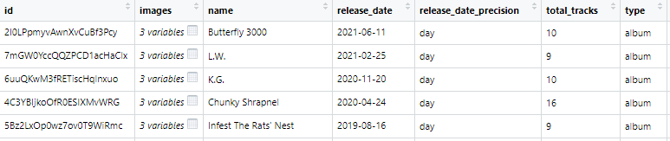
Data II – Search artist on Spotify and get albums
R package: spotifyr for spotify api
Take name from list
If >50, loop
Try to catch when there are repeat albums. E.g. “Album” and “Album (Deluxe Edition)”

Slide 5
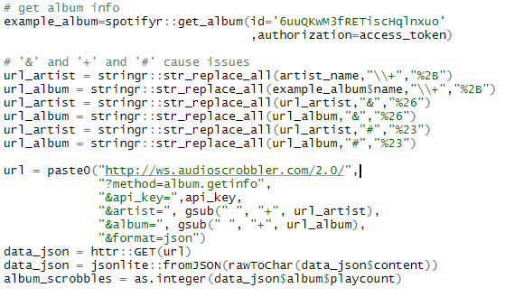

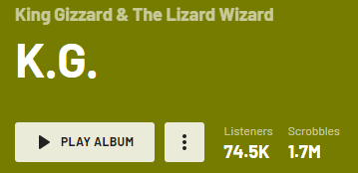

Data III – Last.FM
Spotify does NOT have number of listens! -> Rely on a proxy using Last.fm “scrobbles”
"http://ws.audioscrobbler.com/2.0/
?method=album.getinfo
&api_key=xxxx
&artist=King+Gizzard+%26+The+Lizard+Wizard
&album=K.G.&format=json"

Slide 6

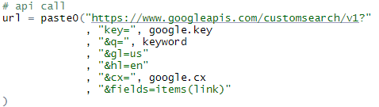

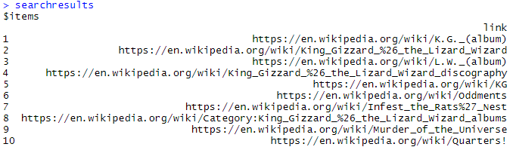
Data IV – Use Google api to search for Wikipedia article
https://www.googleapis.com/customsearch/v1?
key=xxxxxxxx
&q=King+Gizzard+The+Lizard+Wizard+K+G+album
&gl=us
&hl=en
&cx=xxxxxxxx
&fields=items(link)

Slide 7
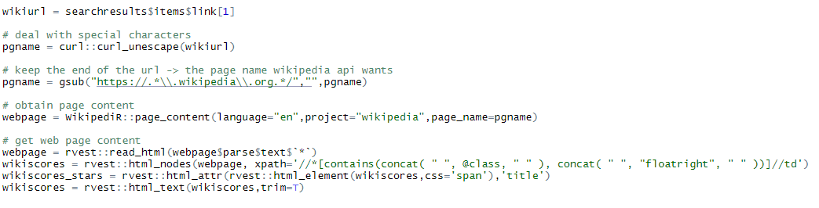
Data V – Get wiki page from Wikipedia api
VERY IMPORTANT

Slide 8
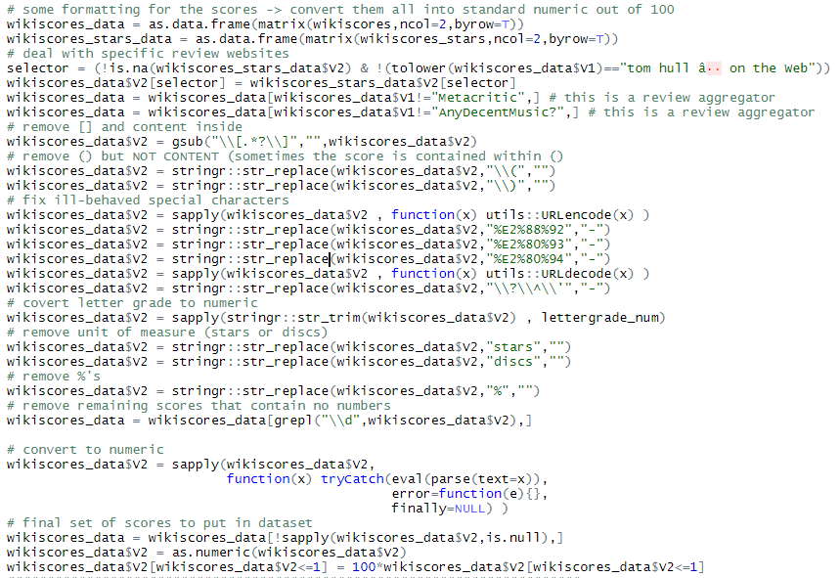
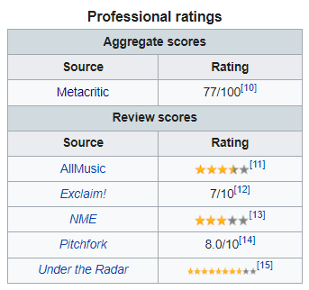


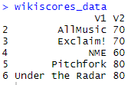
Data VI – Parse Wikipedia page

Slide 9
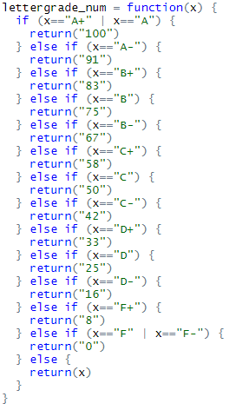
Aside: how to amalgamate scores?
Numeric scores scaled to 100
e.g. 3.5 stars out of 4 -> 87.5
Letter grades assigned scores based on Metacritic rules.
Compute simple unweighted summary statistics
Mean, median, sd, IQR, min, max
Source: How We Create the Metascore Magic - Metacritic

Slide 10
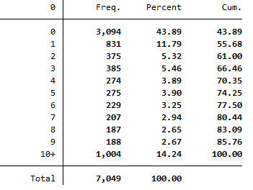
Summary Stats – Number of review scores
484 artists with 2,749 albums

Slide 11

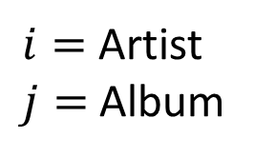
Model
Artist fixed effect
# days album has been out (spotify)
$$\log{s_{ij}}=α_{0}+α_{i}+γ\log{n_{ij}}+{\log{score}}_{ij}+ε_{ij}$$
Scrobbles (Last.fm)
$i=$ Artist
$j=$ Album
$$ε_{i}\sim N(0,Σ_{i})$$
Aggregated scores (wikipedia)
$$\log{s_{ij}}=α_{0}+α_{i}+\log{s_{i,j−1}}+γ\log{n_{ij}}+{\log{score}}_{ij}+ε_{ij}$$

Slide 12
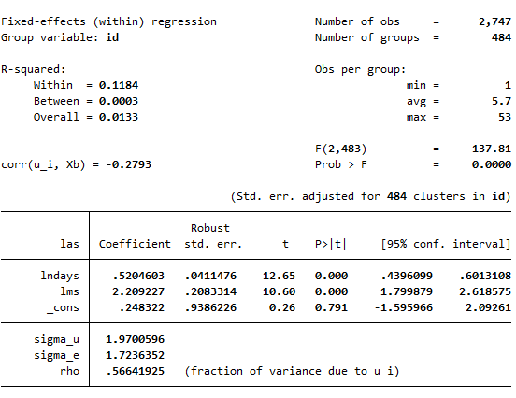

Results – Regress $\log{s_{ij}}$ on ${\log{score}}_{ij}$
Example: King Gizzard’s K.G. Album
Mean review score = 70 -> log(score) = 4.24
Scrobbles = 1.7mil -> log(s) = 14.3
Mean review score = 80 -> log(score) = 4.38
E[log(s)|score=80] = 14.3 + (4.38-4.24) = 14.44
=> s = exp(14.44) = 1.9mil
So improving review scores by 10 points results in ~100,000 extra (lifetime) scrobbles.
If each listen is $0.003, then then they would earn an additional $300 from streaming.

Slide 13
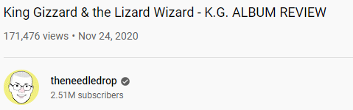
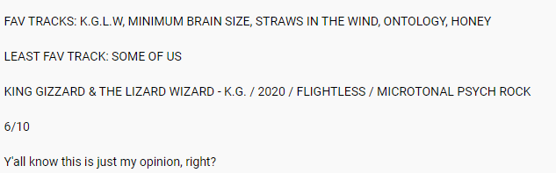
Future work
Additional variables of interest
Demographics from wikipedia
Additional info on tracks from Spotify (genre, tempo, key, etc.)
Review scores from The Needle Drop -> “new” vs “traditional” media
Views
Track recommendations
Review score

